Slide 1
I Ain’t No Data Scientist, Why Do I Need Jupyter Notebooks?
Rob Sewell

Slide 2
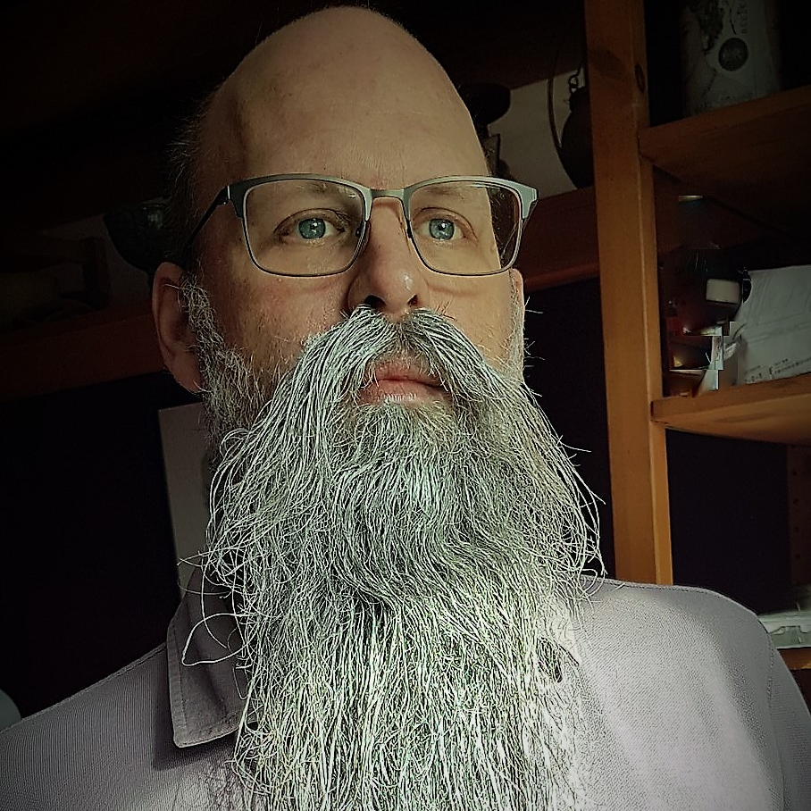
Rob Sewell
Bearded Consultant
Automator
Trainer
Dual MVP
Consultant Sewells Consulting Ltd
dbatoolsMoL dbachecks
ADSNotebooks PowerShell Community
Data Community
beard.media\book
@sqldbawithbeard
blog.robsewell.com

Slide 3
Rob Sewell
Bearded Consultant
Automator
Trainer
Dual MVP
Consultant Sewells Consulting Ltd
dbatoolsMoL dbachecks
ADSNotebooks PowerShell Community
Data Community
beard.media\book
@sqldbawithbeard
blog.robsewell.com
Notes:
OBS:SpeakerCircle

Slide 4
Rob Sewell
Bearded Consultant
Automator
Trainer
Dual MVP
Consultant Sewells Consulting Ltd
dbatoolsMoL dbachecks
ADSNotebooks PowerShell Community
Data Community
beard.media\book
@sqldbawithbeard
blog.robsewell.com
Notes:
OBS:SpeakerCircleandSide

Slide 5

I Ain’t No Data Scientist
Why Do I Need Jupyter Notebooks?
Notes:
OBS:SpeakerBottomLeftSquare

Slide 6
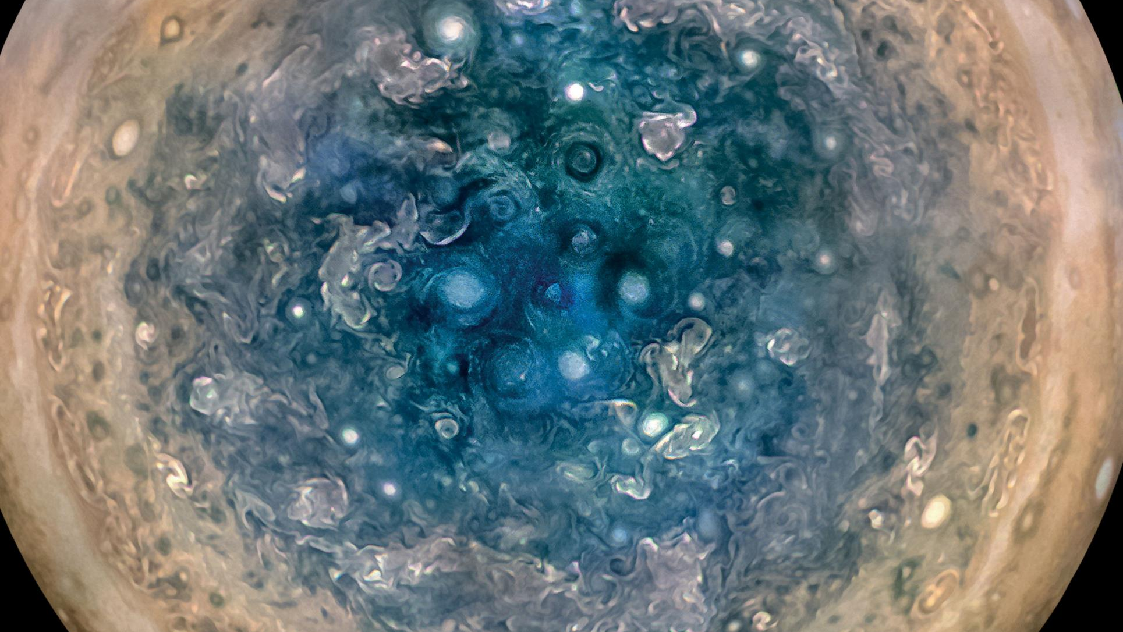

Slide 7
First, the names comes from the planet Jupiter. We wanted to pick a name that evoked the traditions and ideas of science.
Jupyter
Notes:
OBS:SpeakerTopRight

Slide 8
Jupyter
First, the names comes from the planet Jupiter. We wanted to pick a name that evoked the traditions and ideas of science.
Second, the core programming languages supported by Jupyter are Julia, Python and R. While the name Jupyter is not a direct acronym for these languages, it nods its head in those directions. In particular, the "y" in the middle of Jupyter was chosen to honor our Python heritage. See the logos of these languages in the languages folder of this repo.
https://github.com/jupyter/design/wiki/Jupyter-Logo
Notes:
OBS:SpeakerTopRight

Slide 9
Jupyter
Second, the core programming languages
supported by Jupyter are
Julia, Python and R.
While the name Jupyter is not a direct acronym for these languages, it nods its head in those directions.
In particular, the "y" in the middle of Jupyter was chosen to honor our Python heritage.
Third, Galileo was the first person to discover the moons of Jupiter. His publication on the moons of Jupiter is an early example of research that includes the underlying data in the publication. This is one of the core ideas and requirements for scientific reproducibility. Reproducibility is one of the main focuses of our project.
https://github.com/jupyter/design/wiki/Jupyter-Logo
Notes:
OBS:SpeakerTopRight

Slide 10
Jupyter
Third, Galileo was the first person to discover the moons of Jupiter. His publication on the moons of Jupiter is an early example of research that includes the underlying data in the publication.
This is one of the core ideas and requirements for scientific reproducibility. Reproducibility is one of the main focuses of our project.
https://github.com/jupyter/design/wiki/Jupyter-Logo
Notes:
OBS:SpeakerTopRight

Slide 11
So – What IS a Jupyter Notebook?
Originally for Data Scientists
Notes:
OBS:SpeakerTinySquare

Slide 12
So – What IS a Jupyter Notebook?
Originally for Data Scientists
Notes:
OBS:SpeakerTinySquare

Slide 13

First – Lets go back in time

Slide 14
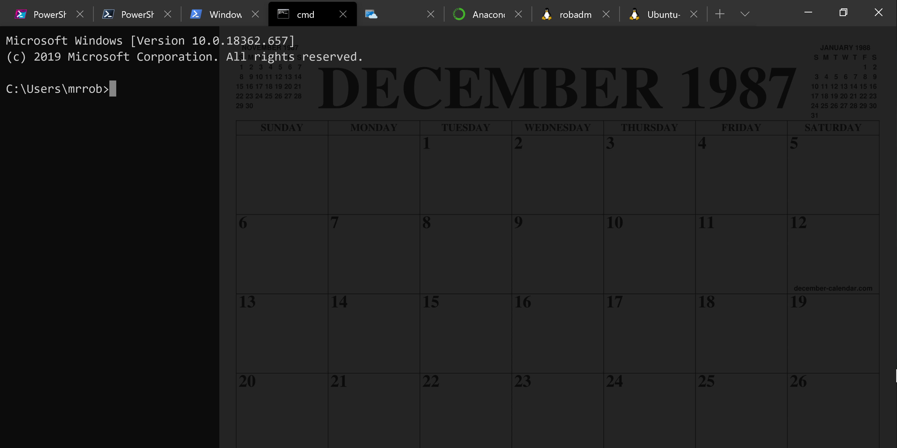
A Decade and a Half

Slide 15
Uh, Houston, we've had a problem
https://en.wikipedia.org/wiki/Houston,_we_have_a_problem

Slide 16

Running Queries

Slide 17
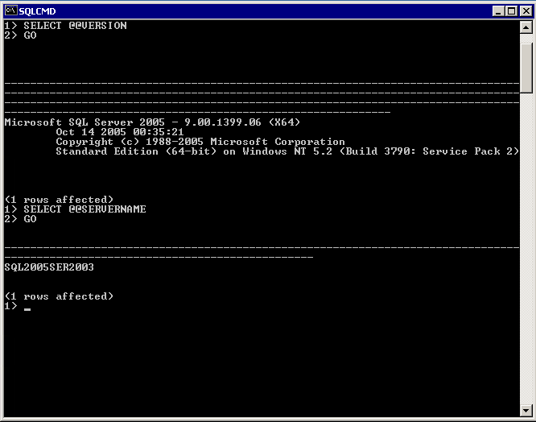
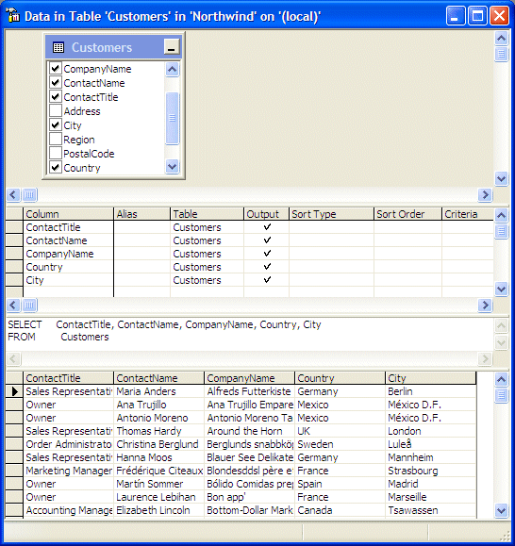

Slide 18
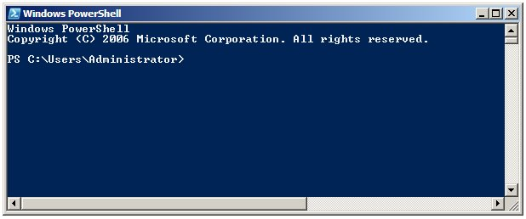
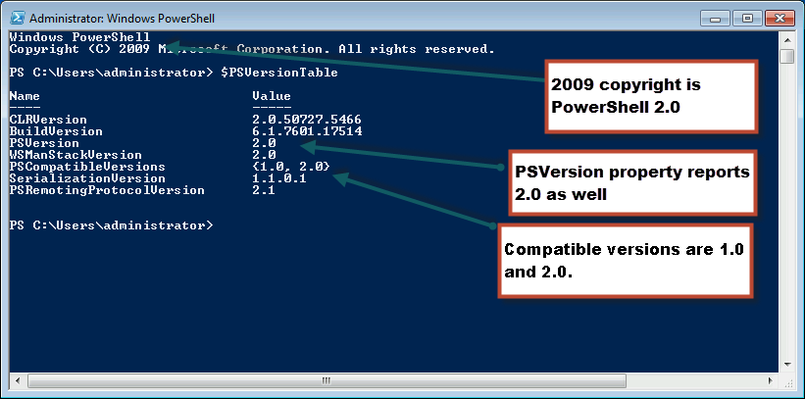
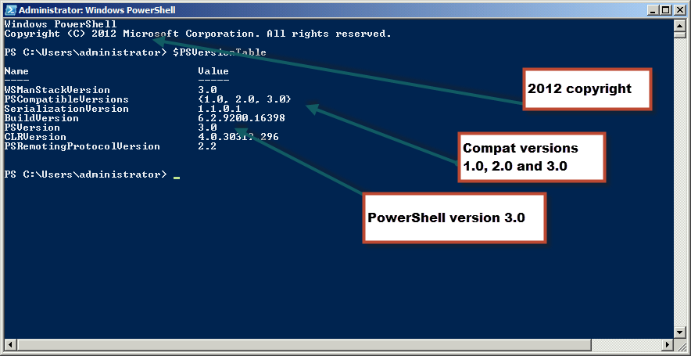
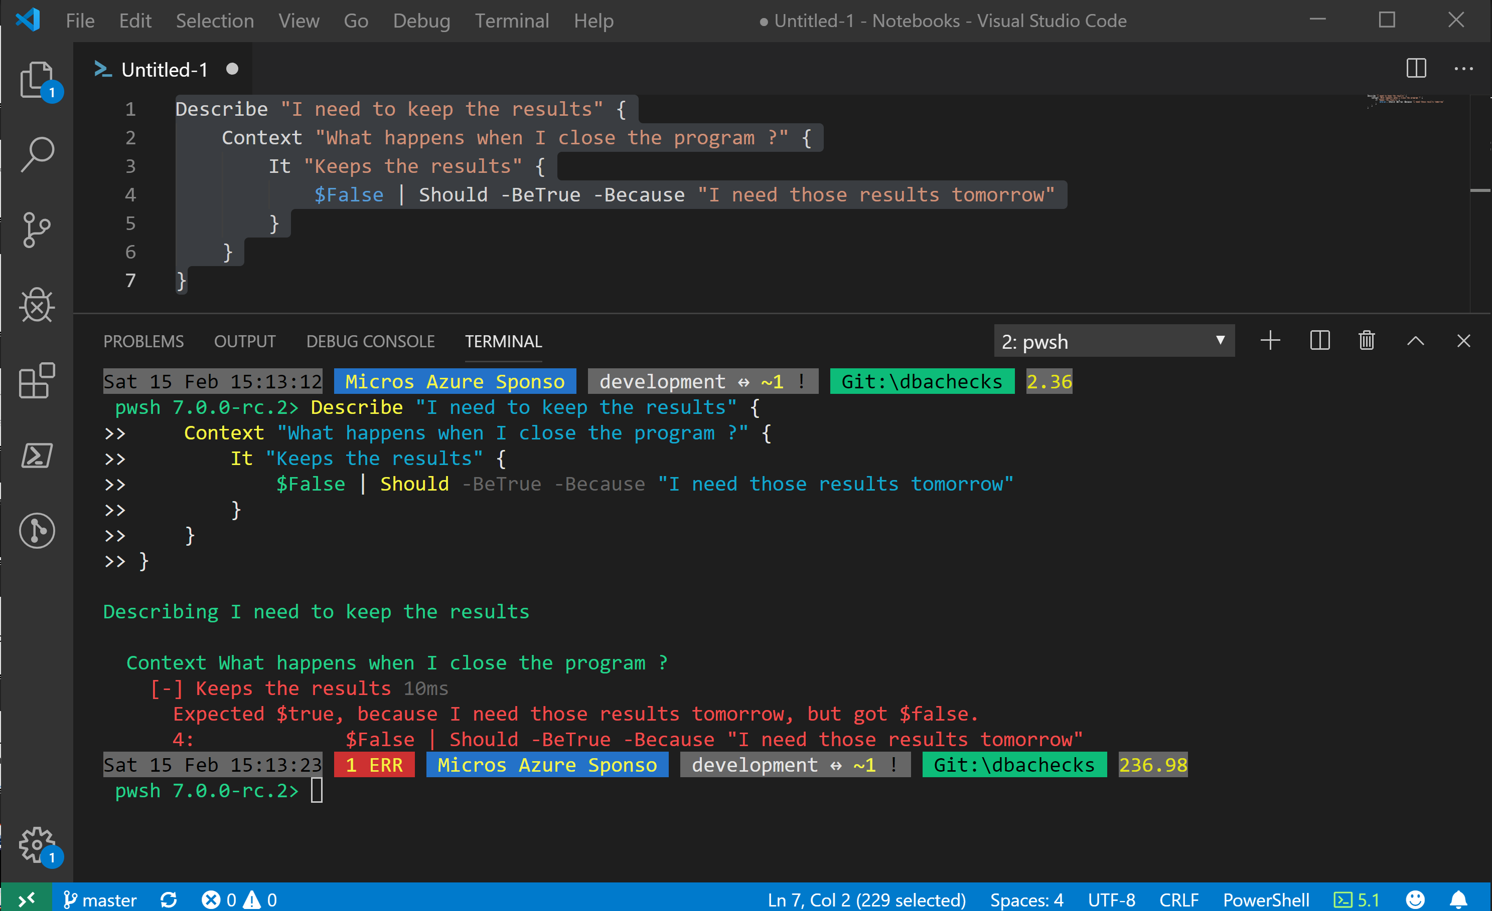
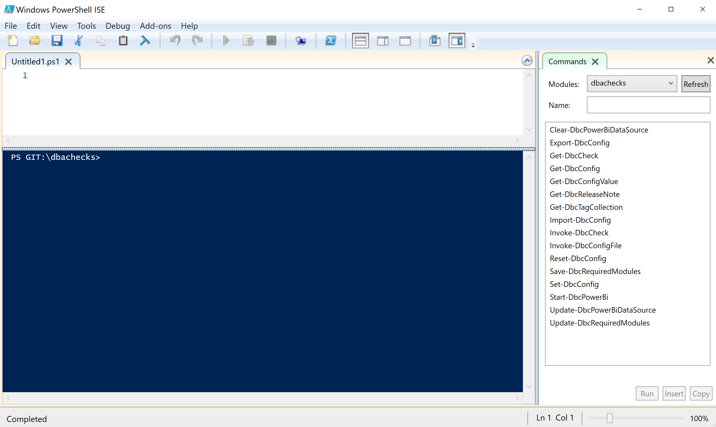
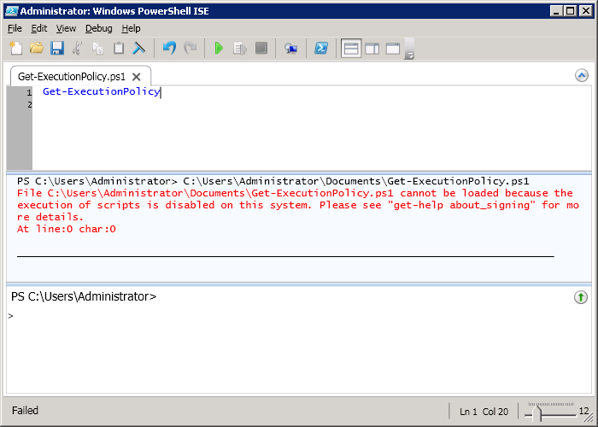
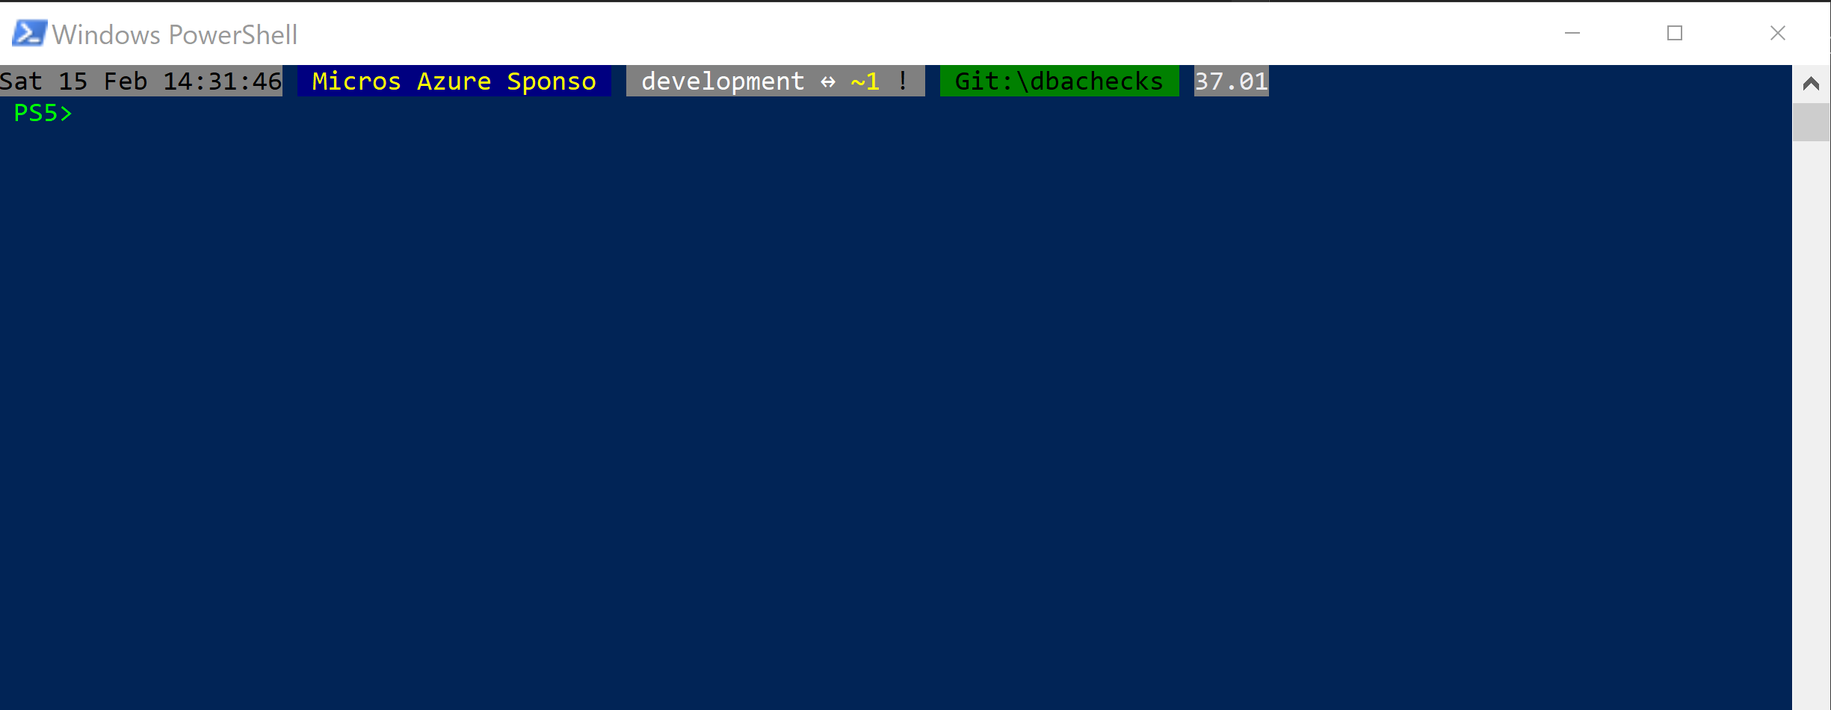
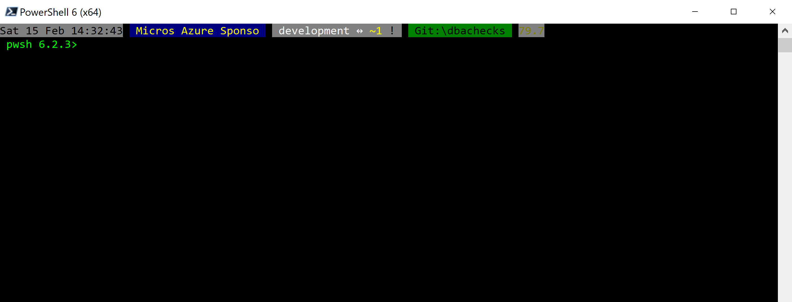
Without some effort………..
Notes:
OBS:SpeakerCentreBottom

Slide 19
Without some effort………..
Notes:
OBS:SpeakerCentreBottom

Slide 20
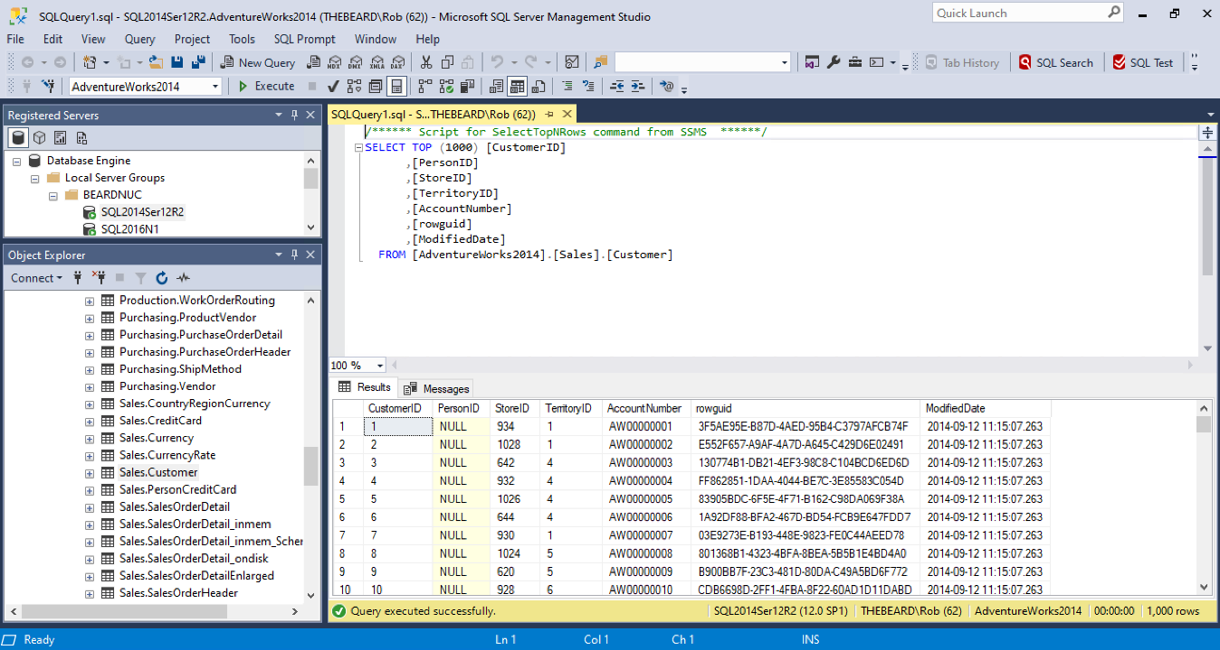

Slide 21
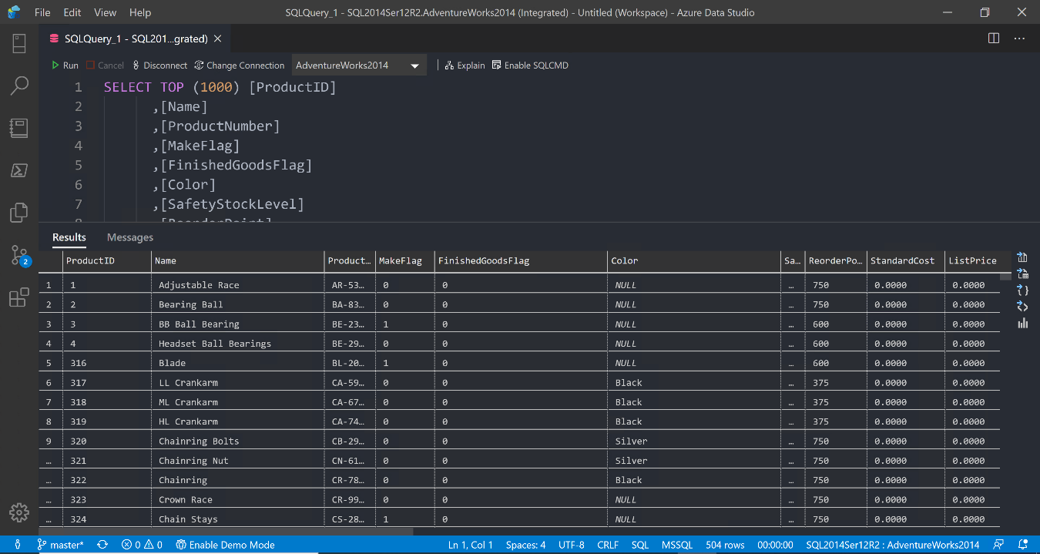

Slide 22
Notes:
OBS:SpeakerTopRight

Slide 23


Slide 24


Slide 25
ALL
GONE

Slide 26
What is a Jupyter Notebook?
Document that can contain text, code, images and query results
Notes:
OBS:SpeakerCentreBottom

Slide 27
What is a Jupyter Notebook?
Document that can contain text, code, images and query results
Notes:
OBS:SpeakerCentreBottom

Slide 28
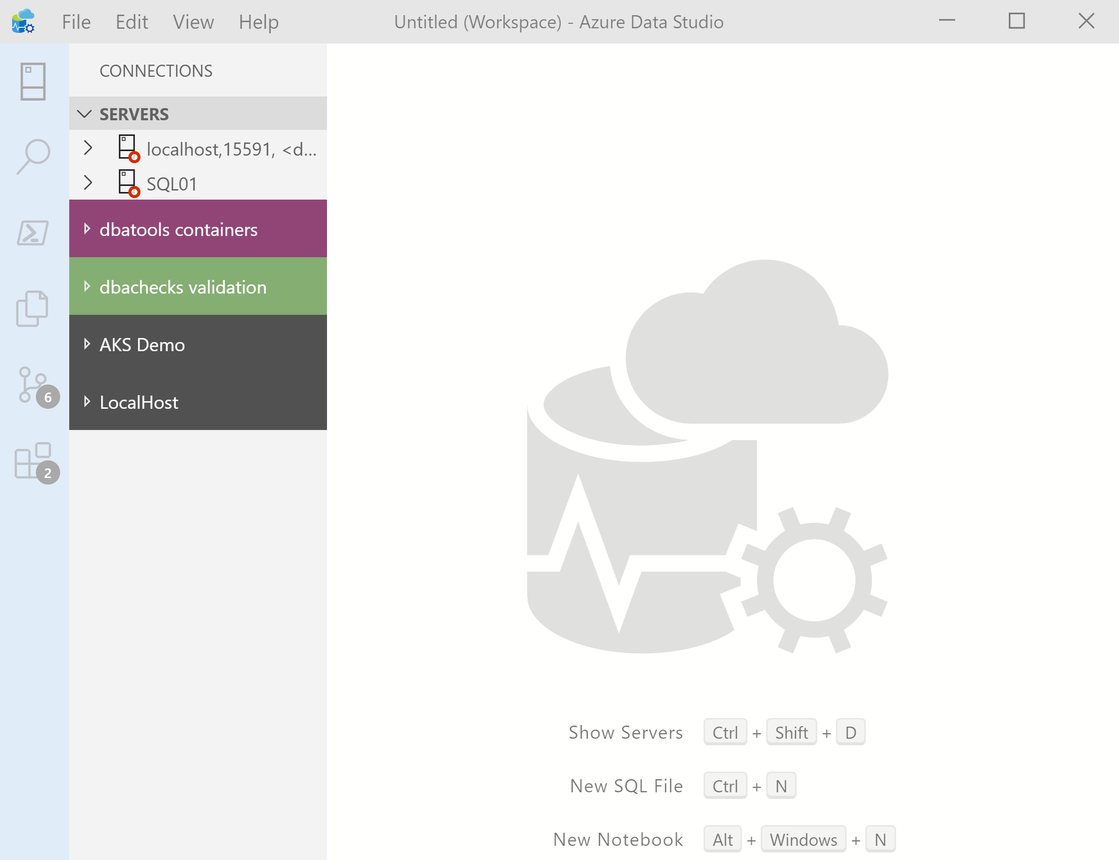
What’s Azure Data Studio ?
Cross Platform desktop environment for Data Professionals
Notes:
OBS:SpeakerCentreSquare

Slide 29
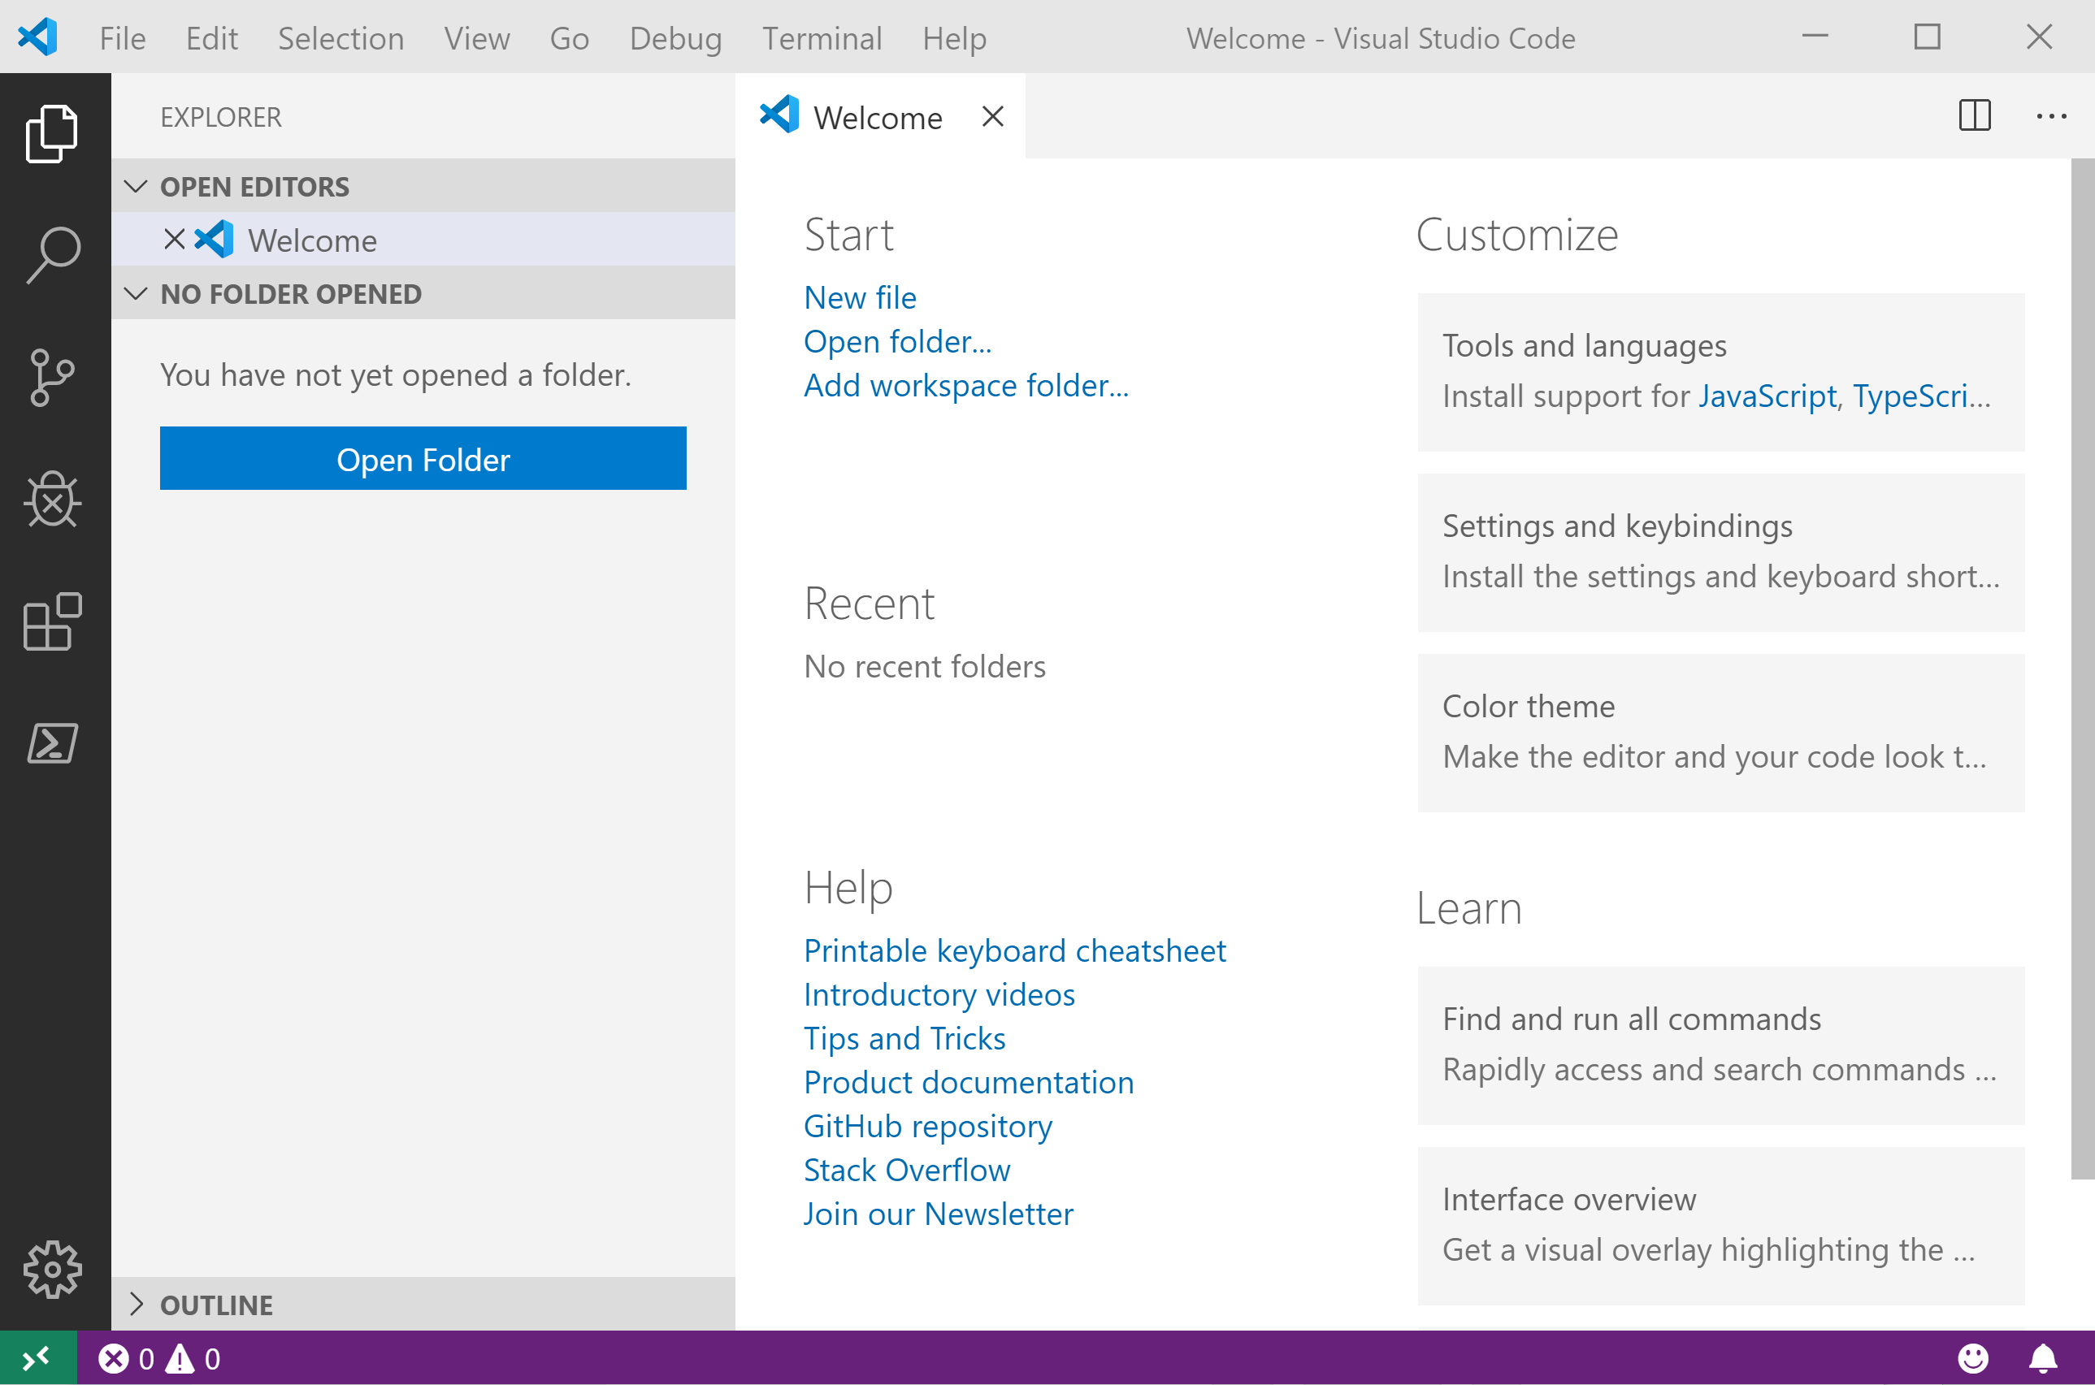
It Looks Like Visual Studio Code ?
Notes:
OBS:SpeakerCentreSquare

Slide 30
It Looks Like Visual Studio Code ?

Slide 31
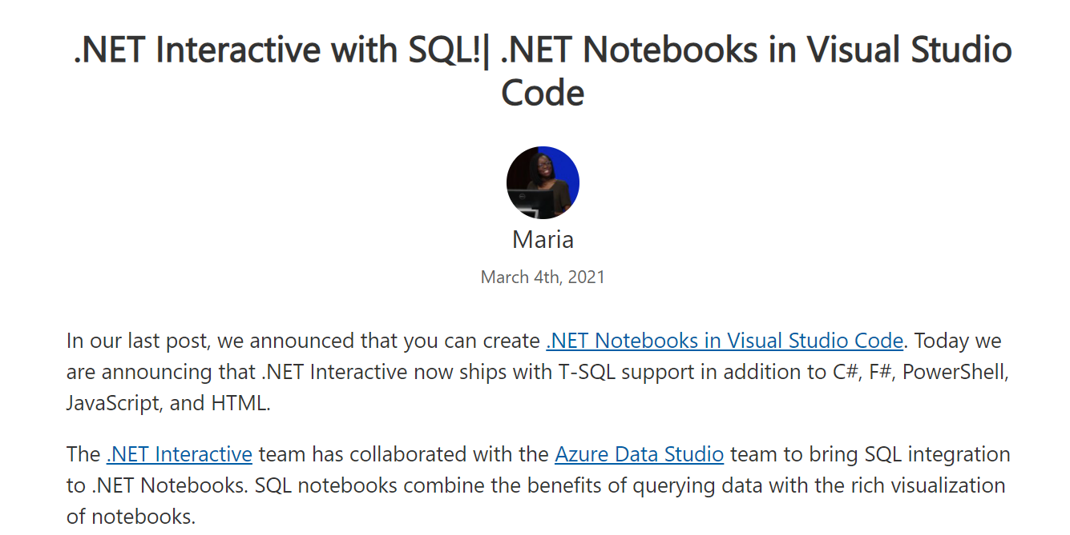
.NET Interactive Notebooks
https://devblogs.microsoft.com/dotnet/net-interactive-with-sql-net-notebooks-in-visual-studio-code/

Slide 32
.NET Interactive Notebooks
All the goodness of Jupyter Notebooks with added
PowerShell Core (and C#) (and F#) (and HTML) (and JavaScript) and SQL now too

Slide 33
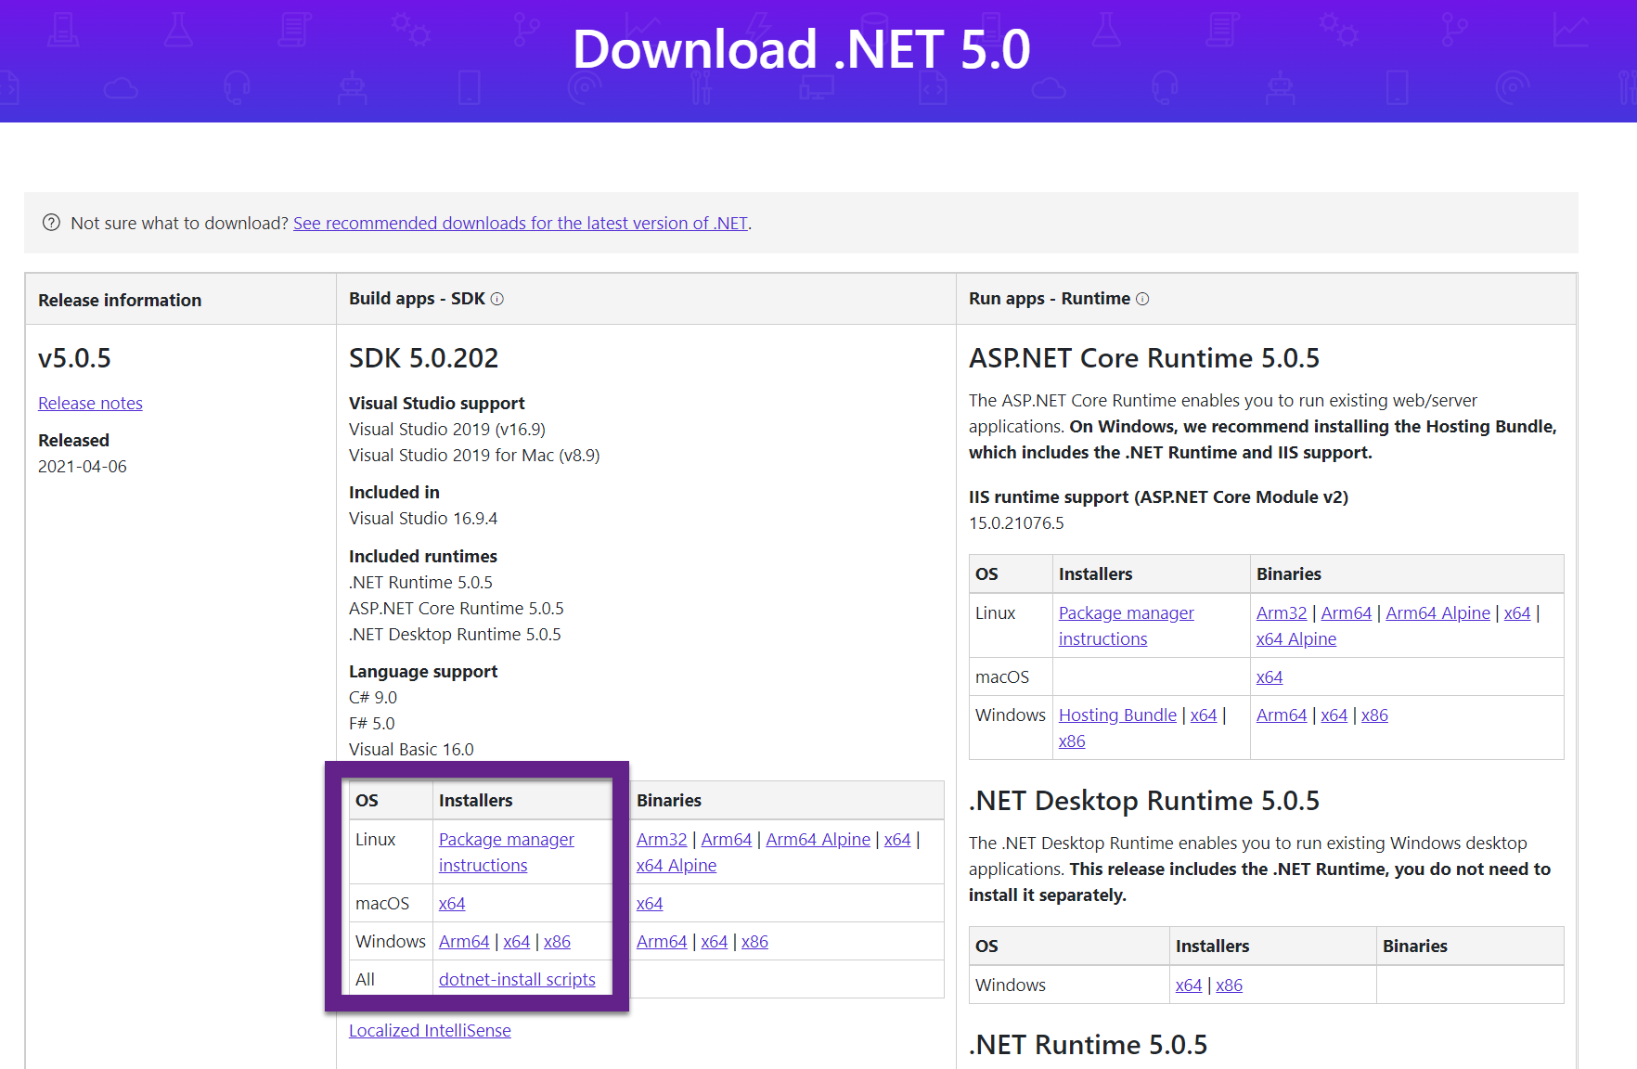
.NET Interactive Notebooks
https://dotnet.microsoft.com/download/dotnet/5.0

Slide 34
.NET Interactive Notebooks
https://dotnet.microsoft.com/download/dotnet/5.0
If you have earlier releases – you MAY need to uninstall and repair - YMMV

Slide 35
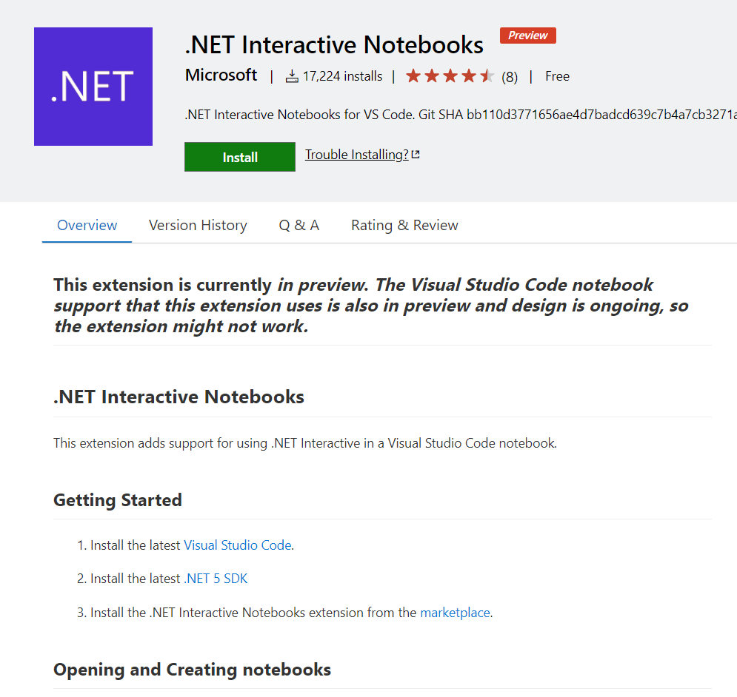
.NET Interactive Notebooks
https://marketplace.visualstudio.com/items?itemName=ms-dotnettools.dotnet-interactive-vscode

Slide 36
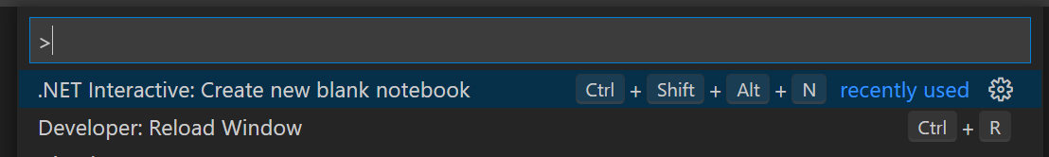
.NET Interactive Notebooks
CTRL + SHIFT + P – Always use this

Slide 37
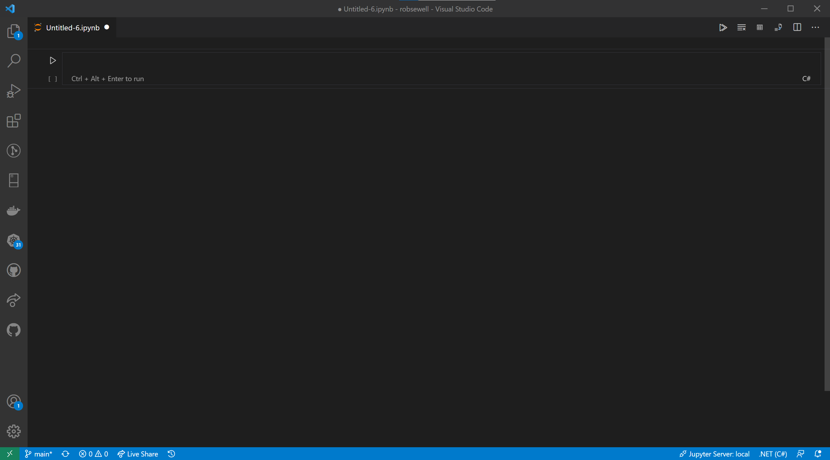

Slide 40
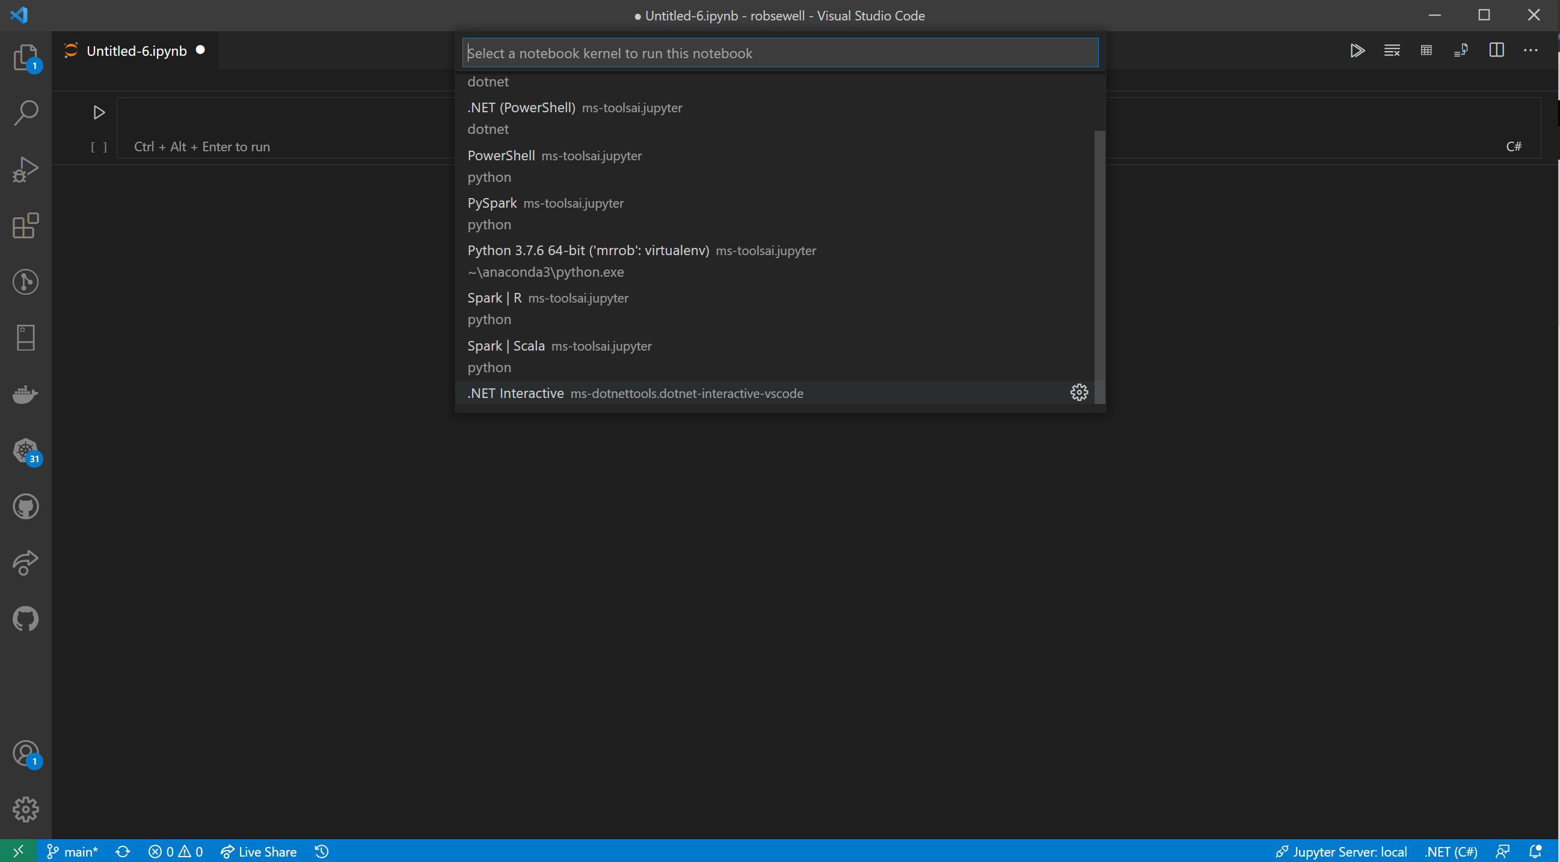

Slide 41
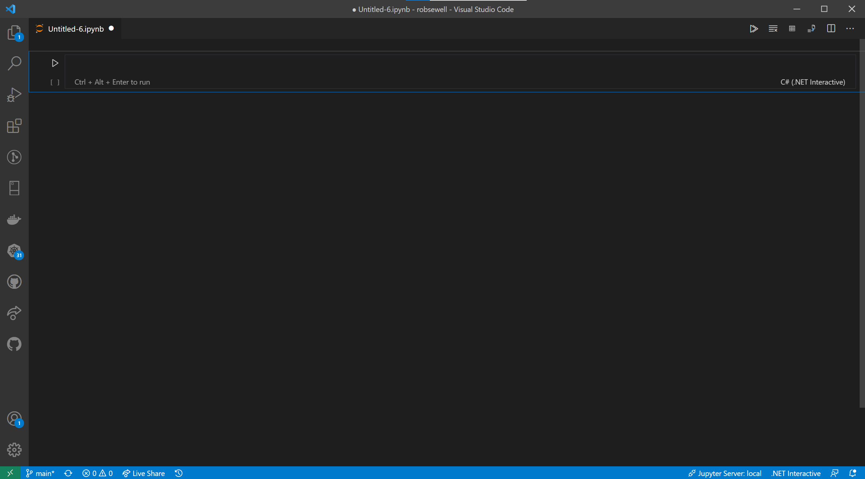

Slide 44
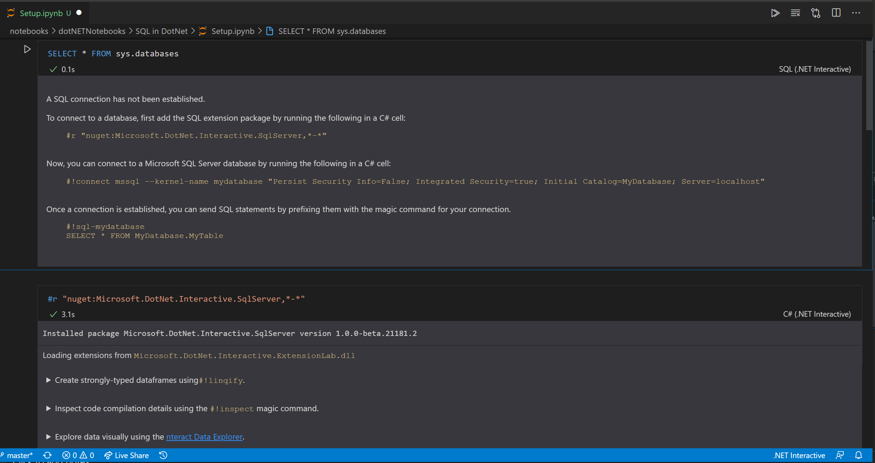

Slide 49
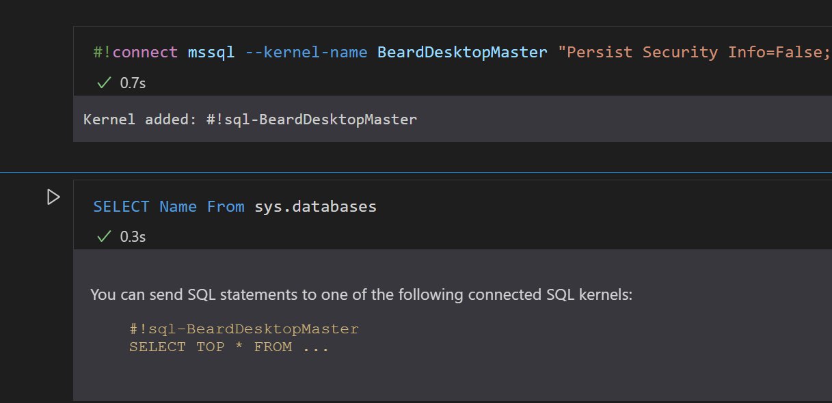
#!connect mssql --kernel-name BeardDesktopMaster "Persist Security Info=False; Integrated Security=true; Initial Catalog=master; Server=localhost"

Slide 50
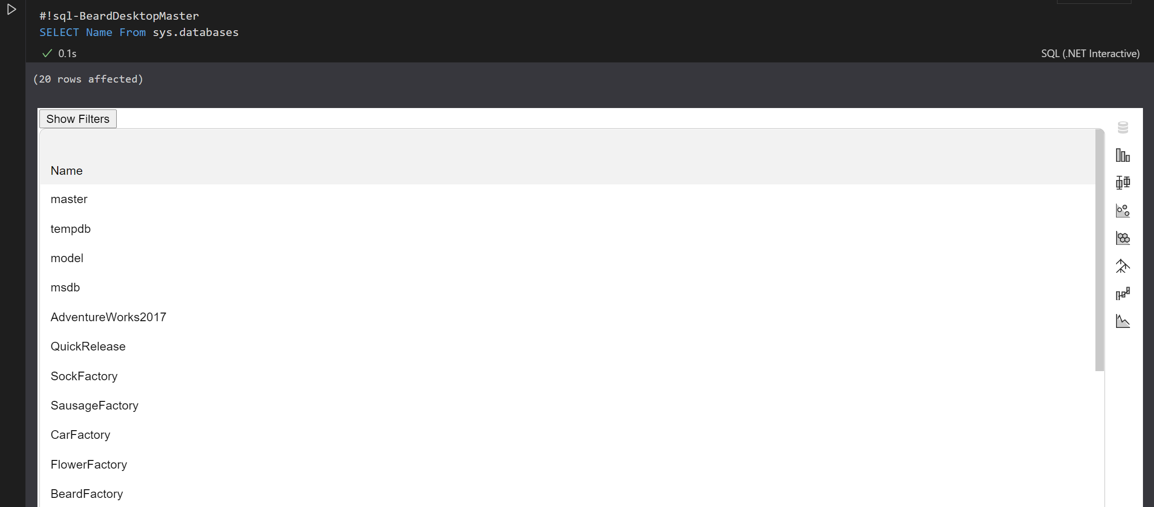

Slide 51
Notebook Mode in the PowerShell Preview extension for Visual Studio Code
https://devblogs.microsoft.com/powershell/public-preview-of-notebook-mode-in-the-powershell-preview-extension-for-visual-studio-code/

Slide 52
Whatcha gonna do?
Incident Response
Run Books – Common Tasks
Training/ New Starter Introduction
Demos – Clients/team members/boss/ presentations/open source

Slide 53

Photo by naomi tamar on Unsplash

Slide 54







Incident Response Flow & Ecosystem
From Julie @MSSQLGirl https://github.com/MsSQLGirl/jubilant-data-wizards
System Event / User Reported Incident
Use existing notebooks
Create new notebooks
Add reusable notebook
Rate existing notebooks
Log adhoc notebook in incident system
Update notebook if necessary
Automate
Incident Response System
Investigate & Mitigate
Use Notebook as the incident’s audit trail
Post Mortem
Analyze and enrich Troubleshooting Repo
Troubleshooting Notebook Repo
Notes:
JULIE

Slide 55
Enough talk
Lets see it!
Notes:
OBS:SpeakerTopRight

Slide 56
Wondering how I did this?
Bit of PowerShell
PowerPoint
And StreamLabs Obs
https://beard.media/slobsautomation
Notes:
OBS:SpeakerTopRight

